Slide 1



Splash Screen

Slide 2
Lesson Menu
Then/Now
New Vocabulary
Concept Summary: Properties of Exponents
Key Concept: Simplifying Monomials
Example 1: Simplify Expressions
Example 2: Degree of a Polynomial
Example 3: Simplify Polynomial Expressions
Example 4: Simplify by Using the Distributive Property
Example 5: Real-World Example: Write a Polynomial Expression
Example 6: Multiply Polynomials

Slide 3


Then/Now
You evaluated powers. (Lesson 1–1)
Multiply, divide, and simplify monomials and expressions involving powers.
Add, subtract, and multiply polynomials.

Slide 4


Vocabulary
simplify
degree of a polynomial

Slide 5
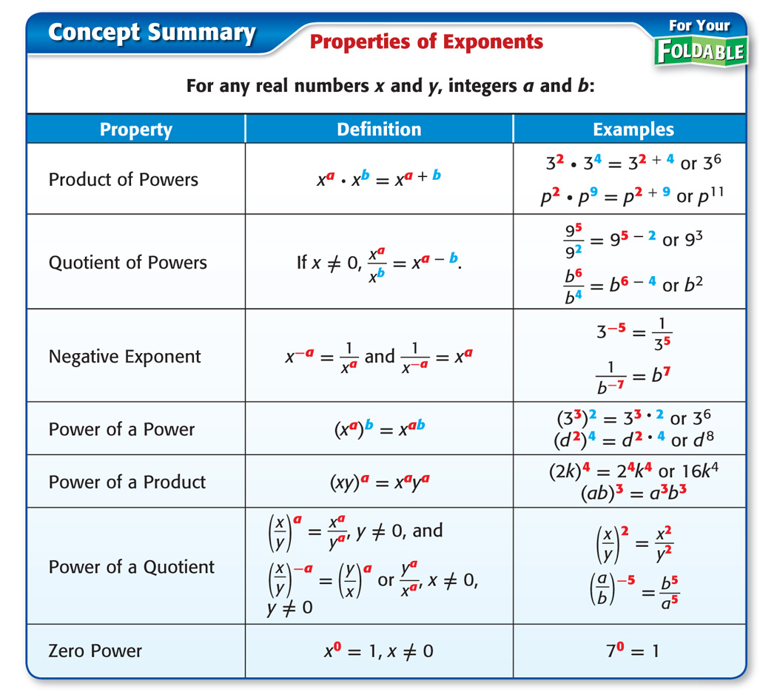
Concept

Slide 6
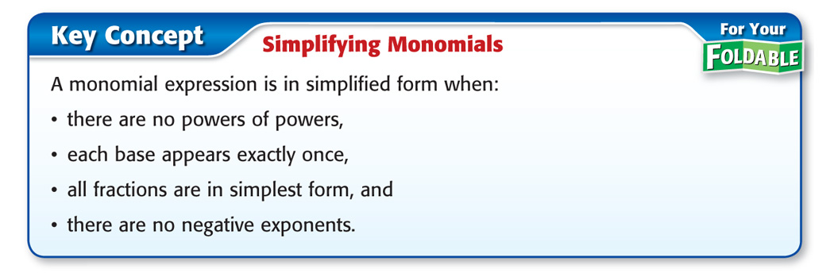
Concept

Slide 7

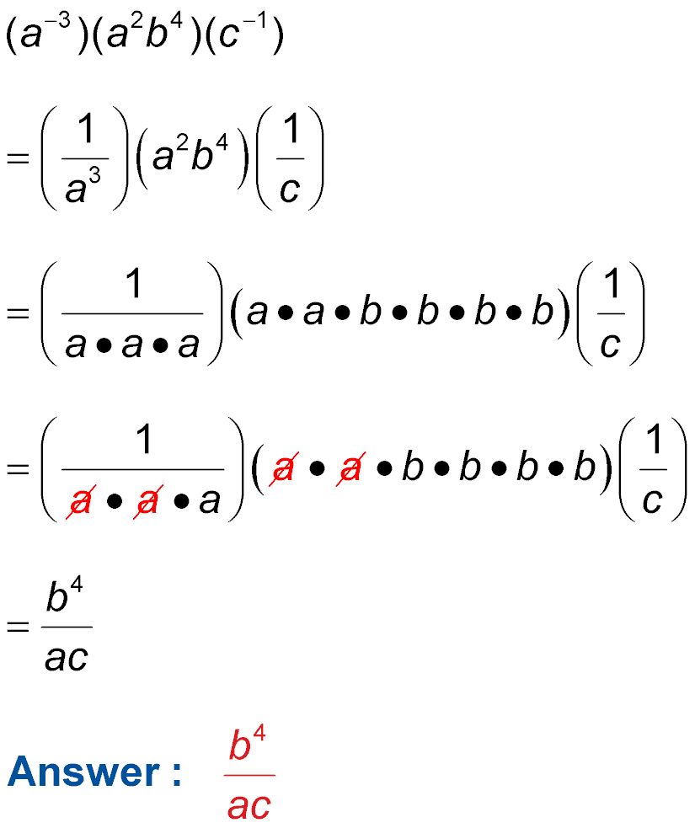
Example 1
Simplify Expressions
A. Simplify the expression . Assume that no variable equals 0.
Original expression
Definition of negative exponents
Definition of exponents

Slide 8

Example 1
Simplify Expressions
Divide out
common factors.
Simplify.

Slide 9
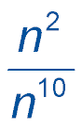
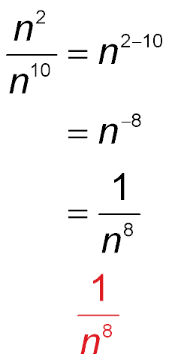
Example 1
Simplify Expressions
B. Simplify the expression . Assume that no variable equals 0.
Quotient of powers
Subtract powers.
Definition of negative exponents
Answer:

Slide 10
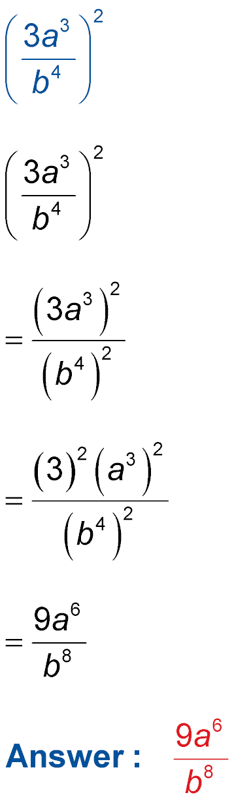
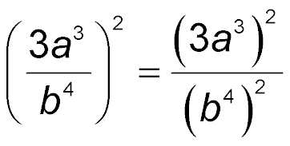
Example 1
Simplify Expressions
C. Simplify the expression . Assume that no variable equals 0.
Power of a quotient
Power of a product

Slide 11
Example 1
Simplify Expressions
Power of a power

Slide 12


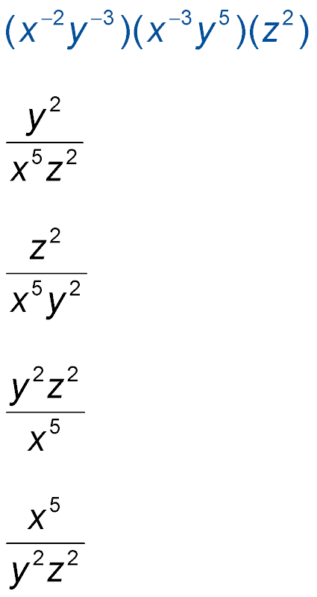
Example 1
A. Simplify the expression . Assume that no variable equals 0.
A.
B.
C.
D.
A
B
C
D

Slide 13
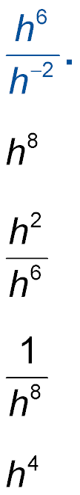
Example 1
B. Simplify the expression Assume that no variable equals 0.
A.
B.
C.
D.
A
B
C
D

Slide 14
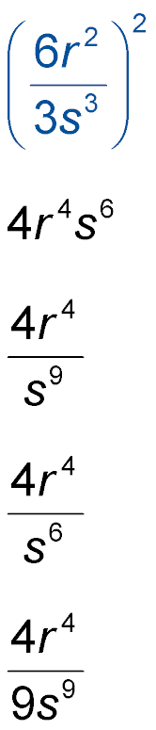
Example 1
C. Simplify the expression . Assume that no variable equals 0.
A.
B.
C.
D.
A
B
C
D

Slide 15
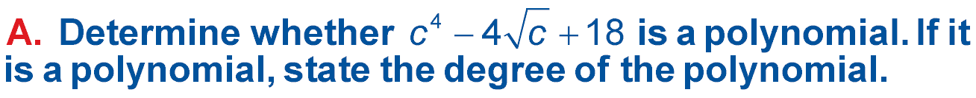
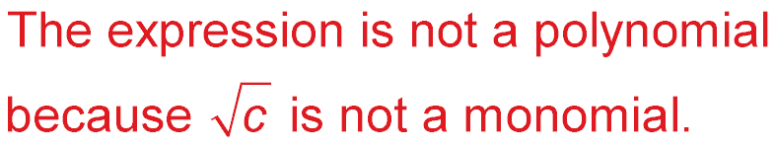
Example 2
Degree of a Polynomial
Answer:

Slide 16
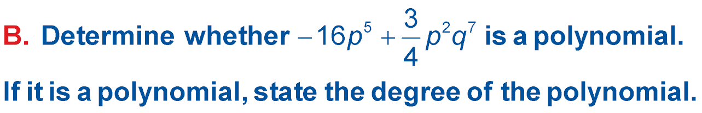
Example 2
Degree of a Polynomial
Answer: This expression is a polynomial because each term is a monomial. The degree of the first term is 5 and the degree of the second term is 2 + 7 or 9. The degree of the polynomial is 9.

Slide 17
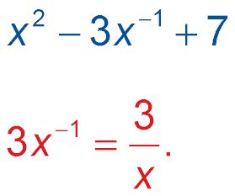
Example 2
Degree of a Polynomial
C. Determine whether is a polynomial. If it is a polynomial, state the degree of the polynomial.
Answer: The expression is not a polynomial because
is not a monomial:
Monomials cannot contain variables in the denominator.

Slide 18
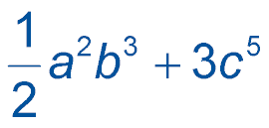
Example 2
A. Is a polynomial? If it is a polynomial, state the degree of the polynomial.
A. yes, 5
B. yes, 8
C. yes, 3
D. no
A
B
C
D

Slide 19

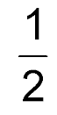
Example 2
B. Is a polynomial? If it is a polynomial, state the degree of the polynomial.
A. yes, 2
B. yes,
C. yes, 1
D. no
A
B
C
D

Slide 20

Example 2
C. Is a polynomial? If it is a polynomial, state the degree of the polynomial.
A. yes, 5
B. yes, 6
C. yes, 7
D. no
A
B
C
D

Slide 21
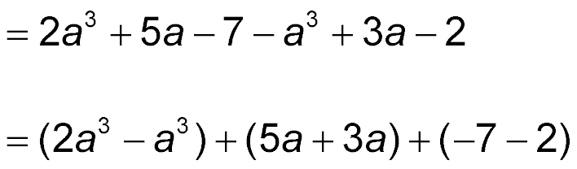
Example 3
Simplify Polynomial Expressions
A. Simplify (2a³ + 5a – 7) – (a³ – 3a + 2).
(2a³ + 5a – 7) – (a³ – 3a + 2)
Distribute the –1.
Group like terms.
= a³ + 8a – 9 Combine like terms.
Answer: a³ + 8a – 9

Slide 22
Example 3
Simplify Polynomial Expressions
B. Simplify (4x² – 9x + 3) + (–2x² – 5x – 6).
Align like terms vertically and add.
4x² – 9x + 3
(+) –2x² – 5x – 6
2x² – 14x – 3
Answer: 2x² – 14x – 3

Slide 23
Example 3
A. Simplify (3x² + 2x – 3) – (4x² + x – 5).
A. 7x ² + 3x – 8
B. –x ² + 3x – 8
C. –x ² + 3x + 2
D. –x ² + x + 2
A
B
C
D

Slide 24
Example 3
B. Simplify (–3x² – 4x + 1) – (4x² + x – 5).
A. 9x ² + 6x + 7
B. –7x ² – 5x + 6
C. 3x ² – 6x + 7
D. 3x ² – 2x + 6
A
B
C
D

Slide 25
Example 4
Simplify by Using the Distributive Property
Find –y(4y² + 2y – 3).
–y(4y² + 2y – 3)
= –y(4y²) – y(2y) – y(–3) Distributive Property
= –4y³ – 2y² + 3y Multiply the monomials.
Answer: –4y³ – 2y² + 3y

Slide 26
Example 4
Find –x(3x³ – 2x + 5).
A. –3x² – 2x + 5
B. –4x² – 3x² – 6x
C. –3x⁴ + 2x² – 5x
D. –3x⁴ – 2x³ + 5x
A
B
C
D

Slide 27
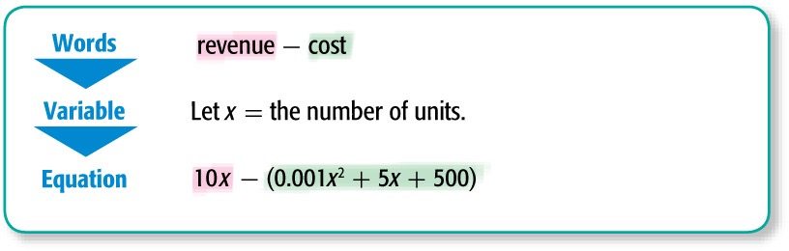
Example 5
Write a Polynomial Expression
E-SALES A small online retailer estimates that the cost, in dollars, associated with selling x units of a particular product is given by the expression
0.001x ² + 5x + 500. The revenue from selling
x units is given by 10x. Write a polynomial to represent the profits generated by the product if profit = revenue – cost.

Slide 28
Example 5
Write a Polynomial Expression
10x – (0.001x ² + 5x + 500) Original expression
= 10x – 0.001x ² – 5x – 500 Distributive Property
= –0.001x ² + 5x – 500 Add 10x to –5x.
Answer: The polynomial is –0.001x ² + 5x – 500.

Slide 29
Example 5
INTEREST Olivia has $1300 to invest in a government bond that has an annual interest rate of 2.2%, and a savings account that pays 1.9% per year. Write a polynomial for the interest she will earn in one year if she invests x dollars in the government bond.
A. –0.003x + 24.7
B. – 0.003x + 28.6
C. 0.003x + 28.6
D. 0.003x + 24.7
A
B
C
D

Slide 30
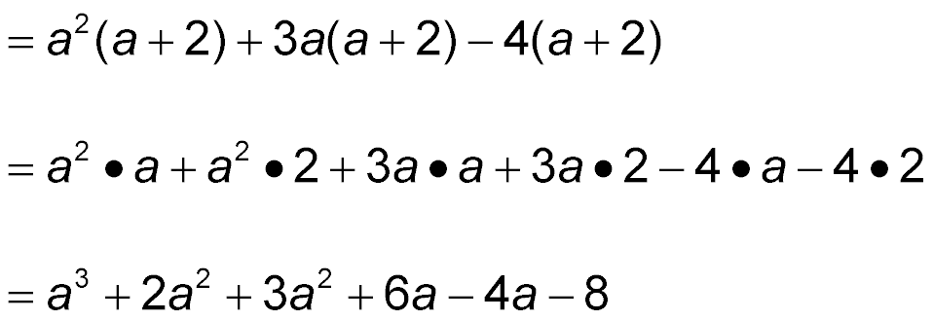
Example 6
Multiply Polynomials
Find (a² + 3a – 4)(a + 2).
(a² + 3a – 4)(a + 2)
Distributive Property
Distributive Property
Multiply monomials.

Slide 31

Example 6
Multiply Polynomials
= a³ + 5a² + 2a – 8 Combine like terms.
Answer: a³ + 5a² + 2a – 8

Slide 32
Example 6
Find (x² + 3x – 2)(x + 4).
A. x ³ + 7x ² + 10x – 8
B. x ² + 4x + 2
C. x ³ + 3x ² – 2x + 8
D. x ³ + 7x ² + 14x – 8
A
B
C
D

Slide 33
End of the Lesson

